Slide 1
Imagine Cup Junior
Lesson Four – How to be an AI inventor
Notes:
This is a title slide that you can have up at the beginning of Lesson Four.

Slide 2

Challenge Check-in
What have you done so far?
You formed a team and identified a specific problem from one of the AI for Good categories. You have formed a team, selected a problem and learned more about it.
You have learned about the basics of AI, generative AI, and how to build with APIs.
What is next?
In this lesson, you are going to be AI inventors and dream up your AI concepts to submit to Imagine Cup Junior!
Notes:
Challenge check-in. This slide is a check-in to recap what the students have learned and what is coming next!

Slide 3






What we will be doing across the six Imagine Cup Junior lessons.
Lesson 1
Lesson 2
Lesson 3
Forming your team and choosing your problem.
Learning about how AI works.
Learning about generative AI.
Lesson 4
Lesson 5
Lesson 6
Becoming a team of AI inventors.
Making sure your AI is good and cyber secure.
Entering a great submission to Imagine Cup Junior.
Notes:
This slide provides a short overview of the six lessons your class will take part in.

Slide 4

What are the names of inventors you can think of and what did they invent? What cool things were invented in your country?
Class Rapid Reflection
Notes:
Rapid Reflection - As a class come have a quick discussion to come up with the names of inventors that you can recall and what they invented. To build their confidence that inventors can come from anywhere, ask if they know any great things that were invented in your country! (It might be cool if you bring the names of some local inventors with you from your own research!)

Slide 5
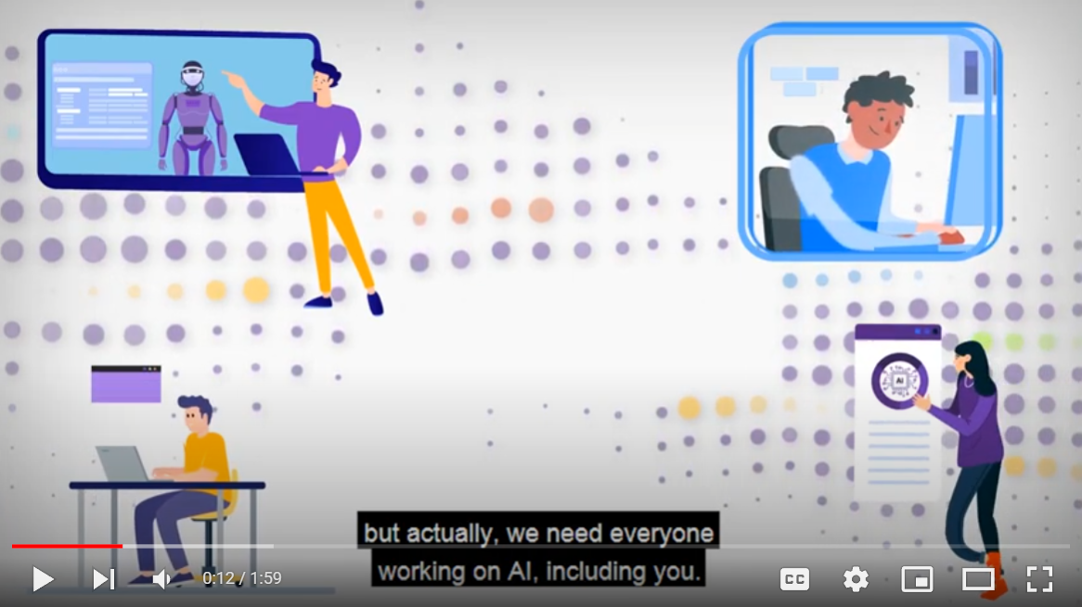

How to be an AI inventor
How to be an AI Inventor | https://youtu.be/Cy-RfZEkRGs
Notes:
In the first video of Lesson Four we share some thoughts on the idea of ‘being an inventor’. This is designed to prime your students to confidently step into inventing their AI concept!

Slide 6
Sprint 1
Inventing your AI
Sprint 2
Building an AI concept
Sprint 3
Final innovation round
Sprint One – Inventing your AI
Goal:
Start inventing your AI concept to the solution that you identified in Lesson One. And be sure to use the APIs that you learned about in Lesson Two (and have put on this slide to remind you!)
Notes:
Sprint One – In the first ten-minute sprint of Lesson Four your students can work in their teams to begin inventing their AI concept. Encourage them to take some lessons from the video and focus their efforts on really trying to solve the problem they identified and create something new! We have included the APIs on the next slide to remind them of the importance of using these tools.

Slide 7






Sprint One – Inventing your AI
Goal: Start inventing your AI concept to the solution that you identified in Lesson One. And be sure to use the APIs that you learned about in Lesson Two (and have put on this slide to remind you!)
Hints: Remember that you get points for how innovative your idea is, so make sure it is new (by having some members of your team research what else already exists to solve the problem you identified).
Vision Computer Vision
Analyze content in images and video.
Custom Vision
Customize image recognition to fit your business needs.
Face
Detect and identify people and emotions in images.
Form Recognizer
Extract text, key-value pairs, and tables from documents.
Ink Recognizer Recognize digital ink and handwriting, and pinpoint common shapes.
Video Indexer
Analyze the visual and audio channels of a video, and index its content.
Speech
Speech to Text
Transcribe audible speech into readable, searchable text.
Text to Speech
Convert text to lifelike speech for more natural interfaces.
Speech Translation
Integrate real-time speech translation into your apps.
Speaker Recognition
Identify and verify the people speaking based on audio.
Language
Immersive Reader
Help readers of all abilities comprehend text using audio and visual cues.
Language Understanding
Build natural language understanding into apps, bots, and IoT devices.
QnA Maker
Create a conversational question and answer layer over your data.
Text Analytics
Detect sentiment, key phrases, and named entities.
Translator
Detect and translate more than 60 supported languages.
Search
Bing Image, News,Video & Web Search
Search across a wide range of terms.
Bing Custom Search
Create a custom search engine with ad-free results.
Bing Entity Search
Recognize and classify named entities, and find search results based on them.
and objects.
Bing Spell Check
Help users identify and fix word breaks, slang, names, homonyms, and brands.
Decision
Anomaly Detector
Identify potential problems early on.
Content Moderator
Detect potentially offensive or unwanted content.
Metrics Advisor
Monitor metrics and diagnose issues.
Personalizer
Create rich, personalized experiences for every user.
Notes:
Sprint One – In the first ten-minute sprint of Lesson Four your students can work in their teams to begin inventing their AI concept. Encourage them to take some lessons from the video and focus their efforts on really trying to solve the problem they identified and create something new! We have included the APIs on this slide to remind them of the importance of using these tools.

Slide 8
How did your team go? Are you feeling good about your idea, or do you still need to come up with a few more concepts?
Rapid Reflection
Notes:
Rapid Reflection: To bring your class back from the sprint, do a quick reflection on how they went through that sprint, and see how their initial ideas are coming together.

Slide 9

Developing Your Idea
Developing Your Idea | https://youtu.be/cMT6ZQlJYMw
Notes:
In the second video for Lesson Four we provide your students with some more innovation tools to help them with their ideas.

Slide 10
Sprint 1
Inventing your AI
Sprint 2
Continuing to invent
Sprint 3
Final innovation round
Sprint Two – Continuing to invent
Goal:
To spend the final ten minutes of this lesson with your team and working on your idea to make it stronger. Use the 123 Step Process!
Notes:
Sprint Two – In the second ten-minute sprint of Lesson Four your students can again work in their teams to begin inventing their AI concept. Encourage them to take some lessons from the second video and continue to move towards a great idea!

Slide 11
Sprint Two – Continuing to invent
Goal: Keep improving on your idea, and use some of the lessons you just learned in the last video.
Vision Computer Vision
Analyze content in images and video.
Custom Vision
Customize image recognition to fit your business needs.
Face
Detect and identify people and emotions in images.
Form Recognizer
Extract text, key-value pairs, and tables from documents.
Ink Recognizer Recognize digital ink and handwriting, and pinpoint common shapes.
Video Indexer
Analyze the visual and audio channels of a video, and index its content.
Speech
Speech to Text
Transcribe audible speech into readable, searchable text.
Text to Speech
Convert text to lifelike speech for more natural interfaces.
Speech Translation
Integrate real-time speech translation into your apps.
Speaker Recognition
Identify and verify the people speaking based on audio.
Language
Immersive Reader
Help readers of all abilities comprehend text using audio and visual cues.
Language Understanding
Build natural language understanding into apps, bots, and IoT devices.
QnA Maker
Create a conversational question and answer layer over your data.
Text Analytics
Detect sentiment, key phrases, and named entities.
Translator
Detect and translate more than 60 supported languages.
Search
Bing Image, News,Video & Web Search
Search across a wide range of terms.
Bing Custom Search
Create a custom search engine with ad-free results.
Bing Entity Search
Recognize and classify named entities, and find search results based on them.
and objects.
Bing Spell Check
Help users identify and fix word breaks, slang, names, homonyms, and brands.
Decision
Anomaly Detector
Identify potential problems early on.
Content Moderator
Detect potentially offensive or unwanted content.
Metrics Advisor
Monitor metrics and diagnose issues.
Personalizer
Create rich, personalized experiences for every user.
Notes:
Sprint Two – In the second ten-minute sprint of Lesson Four your students can again work in their teams to begin inventing their AI concept. Encourage them to take some lessons from the second video and continue to move towards a great idea!

Slide 12
How did your team do in the second sprint? Is it time to focus down onto one idea, or are you still looking at a few?
Rapid Reflection
Notes:
Rapid Reflection – Once again to bring your class back from the sprint, do a quick reflection on how they are going, and prepare them for the third and final sprint of this lesson.

Slide 13
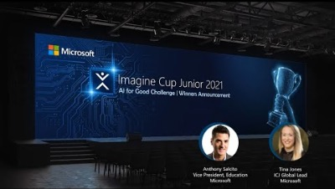
Notes:
Bonus Video! In this third (optional) video for Lesson Four we share some of the great submissions from Imagine Cup Junior 2021 to inspire your class to do something great for this year’s Imagine Cup Junior! The winners are announced from the 7minute 30second mark. Anthony Salcito and Tina Jones explain the concepts and why the teams did so well! Keep an eye on the time here and watch as much as you can! You can also skip over this video if you do not have time and encourage students to watch in their own time.

Slide 14
Sprint 1
Inventing your AI
Sprint 2
Continuing to invent
Sprint 3
Final innovation round
Sprint Three – Continuing to invent
Goal:
Keep improving on your idea and use some of the lessons you just learned in the last video.
Notes:
Sprint #Three – In the third ten-minute sprint of Lesson Four your students can again work in their teams to work on their AI concept. Encourage them to use the 123 step process!

Slide 15
Sprint 3 – Final innovation round
Goal: To spend the final ten minutes of this lesson with your team and working on your idea to make it stronger. Use the 123 Step Process!
Step 1
Data is collected.
Step 2
This data goes into the AI.
Step 2
This data goes into the AI.
What data are you collecting? Which APIs does it use to do this?
What is the AI? What ‘container’ is it in? Is it a smartwatch, or a drone, a robot or a website or something else?
What decisions and outcomes are being made by your AI? Which APIs does it use to do this?
Notes:
Sprint #Three – In the third ten-minute sprint of Lesson Four your students can again work in their teams to work on their AI concept. Encourage them to use the 123 step process!

Slide 16
Challenge Check-in
What have you done so far?
You formed a team and identified a specific problem from one of the AI for Good categories. You have formed a team, selected a problem and learned more about it.
You have learned about the basics of AI and how to build with APIs.
You have learned how to think like an inventor and begun building your AI concept.
What is next?
In the next lesson you are going to engage with the ethics of AI, and ensure they apply to your idea.
Notes:
This is a quick moment to recap what your students achieved in Lesson 3. Specifically, they:
Learned about how to be AI inventors.
Created their AI solution.
In the next lesson, they will work to make their AI’s ‘good’!

Slide 17
Bonus Activity!
If your students want to create an OPTIONAL prototype of their concept, Azure for Students – Free Account Credit | Microsoft Azure can be a platform for them to develop their concept using their favorite languages and create custom apps in Visual Studio.
Notes:
Bonus Activity: If your students want to create an OPTIONAL prototype of their concept, Azure for Students – Free Account Credit | Microsoft Azure can be a platform for them to develop their concept using their favorite languages and create custom apps in Visual Studio.

Slide 18
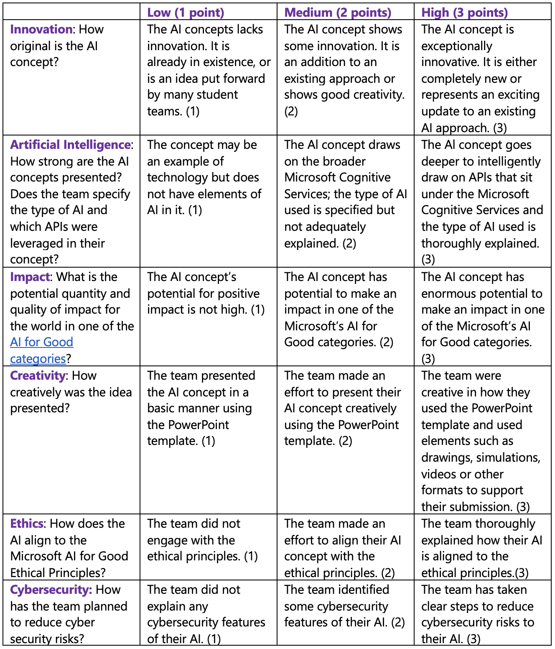
Judging Rubric
This is the rubric used by the judges to assess your student’s submissions. You can share this with your class and use it to guide their AI concepts as they fill out their PowerPoint Submission Template.
Notes:
Judging Rubric - This is the rubric used by the judges to assess your student’s submissions. You can share this with your class and use it to guide their AI concepts as they fill out their PowerPoint Submission Template.

